Slide 1
Environmental Degradation and Disaster Management
NIOS Secondary

Slide 2
Chapter at a glance
In this chapter, we are going to learn about the degradation in environment because of various natural and man-made factors which are responsible for it. Therefore, we shall study the phenomenon of environmental degradation and how it is related to natural calamities, disasters and their management.
Explanation 01 – 23
Exercise 24 – 25
PAGE 00

Slide 3
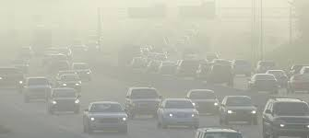
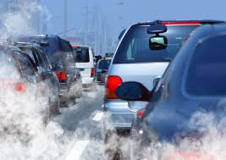
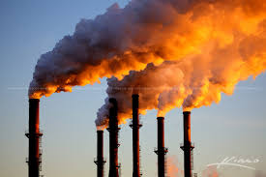
We all feel the impact of air pollution owing to emission of carbon monoxide by large number of vehicles and harmful gases from factories.
Dense smog
Smoke from vehicles
Smoke from factories
We come to know by reading newspapers or listening to discussions on radio or watching on television how the rivers and even the underground water sources are being polluted and the water level is going down fast.
PAGE 01

Slide 4
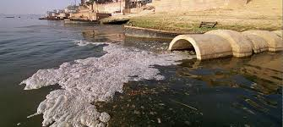
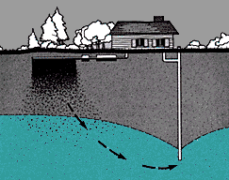
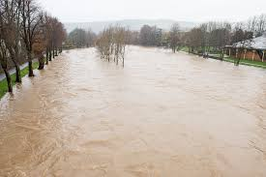
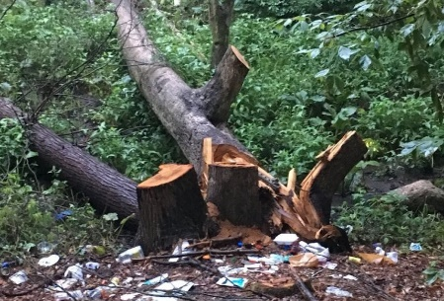
River water pollution
Groundwater pollution
In hilly areas, forests are being cut to meet the fast growing needs of the people. Many of us are aware that all these are adversely affecting our environment.
Causing flood
Deforestation
The deterioration of environment has also led to various kinds of man-made disasters and natural calamities
PAGE 02

Slide 5
MEANING OF ENVIRONMENT
What does the word ‘environment’ mean?
Commonly environment means the surroundings in which we live. In the present context, environment denotes all the elements, processes and conditions around us along with their interrelationships. It is defined as the sum total of all the conditions and circumstances and the living and non- living things around an organism, which affect its life.
Caring for our environment
PAGE 03

Slide 6
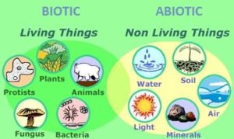
As we find, the environment of any organism has two components, living and non-living. The living component is known as Biotic and includes the organisms themselves, i.e. human beings, plants, animals, other organisms, their food and their interactions. The second component is the non-living, known as Abiotic which includes such items as sunlight, soil, air, water, land, climate etc.
Biotic and Abiotic components
PAGE 04

Slide 7
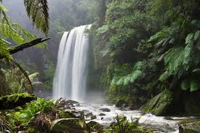
CLASSIFICATION OF ENVIRONMENT
The environment which we are trying to understand is classified on the basis of the process of its creation or evolution. Based on this, environment falls into two main categories:
Natural environment
Human made environment.
Natural environment: It includes all living and non-living things that occur naturally on Earth. It comprises the nature of the living space. The living space may be land or sea, that is, it may be soil or water. It also includes the chemical constituents and physical properties of the living space, the climate, and a variety
of organisms
PAGE 05
Natural environment

Slide 8
Natural environment includes both biotic and abiotic components as these have been evolved through a natural process. The creation of these components has been done by nature, and not by any human intervention or support. It is true that human beings live in an environment where both biotic and abiotic factors influence them and they learn to adapt themselves to these in several ways. But human beings have no role to play in the creation and evolution of natural environment.
Human-made environment: On the other hand, human-made environment includes all those things which are created by humans for their use. Human beings construct these surroundings, as these are needed for providing the required setting for human activity. These things range from the large-scale civic surroundings to personal places.
PAGE 06

Slide 9
Man made environment
For example, houses, roads, schools, hospitals, railway lines, bridges and parks are components of human-made environment.
There is yet another kind of environment which plays an important role in the living conditions of human beings. This is called the social environment. Social environment includes:
Cultural norms and values
The culture that individuals live in,
Social, political, economic and religious institutions with which they interact.
PAGE 07

Slide 10
THE DYNAMISM AND THE VARIETY OF THE ENVIRONMENT
One of the environment’s most significant characteristics is its dynamism. It is continuously changing. Both the biotic and the abiotic elements in the environment are dynamic by their nature. The environment differs from place to place and also from one time in history to another. For example, the environment of the Himalayas is different from that of the Great Indian Desert, and even there it is not the same over the years and decades. Climatic conditions change in different places in different seasons. The environment is dynamic in nature and keeps on changing..
IMPORTANCE OF ENVIRONMENT
We always say that environment is key to our welfare and survival. The environment is our life support system. In fact, it affects and influences the growth, development, and survival of all organisms, including human beings. It supplies the basic necessities for life and supports large number of life forms. We are dependent on the environment for our food, shelter, water, air, soil, energy, medicines, fibres, raw materials, and many other things.
PAGE 08

Slide 11
Human dependence on environment
The environment maintains atmospheric composition and protects all kinds of life on earth from harmful effects of solar radiation. But in spite of all these benefits we find that the quality of environment is deteriorating and it is being degraded continuously. It is not only that the resources of the environment are being irrationally utilised, we are contributing dangerously to its pollution.
PAGE 09

Slide 12
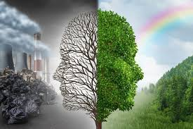
ENVIRONMENTAL DEGRADATION
Environmental degradation is the process by which our environment i.e., air, water and land, is progressively contaminated, overexploited and destroyed. When the environment becomes less valuable or damaged, environmental degradation is said to occur. In specific term, environmental degradation is the deterioration of the environment through depletion of resources such as air, water, soil and forest; the destruction of eco-systems and the extinction of wildlife.
PAGE 10
Environmental degradation

Slide 13
Let us recall our experiences in daily life. We are utilizing resources like water, soil, trees, coal, petrol without caring for the future. We are carelessly interfering with the eco-system and deliberately killing wild animals. In fact, there are many forms of environmental degradation. Whenever habitats are destroyed, biodiversity is lost, or natural resources are depleted, the environment is hurt.
CAUSES OF ENVIRONMENTAL DEGRADATION
Based on the discussion so far, we now know that healthy environment is essential for the very existence of human society and other living organisms. But environmental degradation is going on unabated.
We are being cautioned every now and then about the deterioration in the environment and its consequences like:
PAGE 11

Slide 14
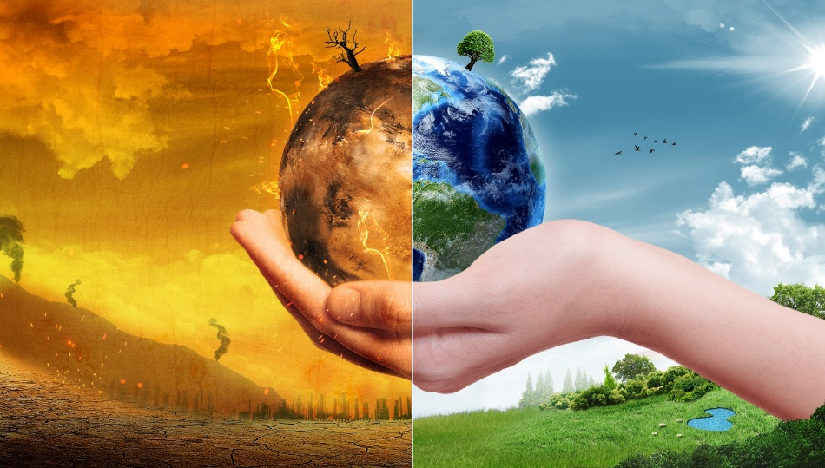
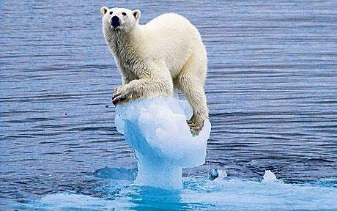
Change in climate
Ice is melting at the Arctic circles due to global warming
Global warming
Changing climatic conditions
Impending water crisis
PAGE 12

Slide 15
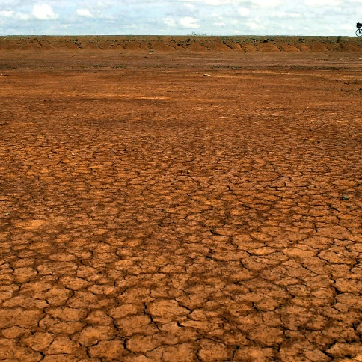
Health hazards due to environmental changes
Decreasing fertility of agricultural land
Increasing health problems.
Decreasing soil fertility
There is an urgent need to take all possible steps to check environmental degradation. The important factors are the following:
PAGE 13

Slide 16
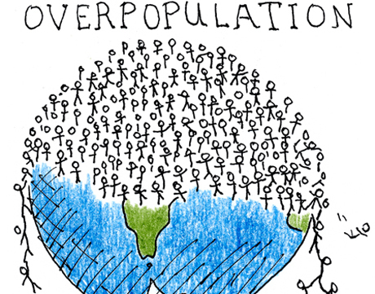
Social Factors
Growing Population: Population is the greatest resource of any country and a major contributory factor for development, and yet it is a major cause of environmental degradation. Huge population also leads to huge production of wastes. The resultant outcomes are loss of biodiversity, pollution of air, water and soil and increased pressure on arable land. All these have been putting great stress on the environment.
PAGE 14
Over Population

Slide 17
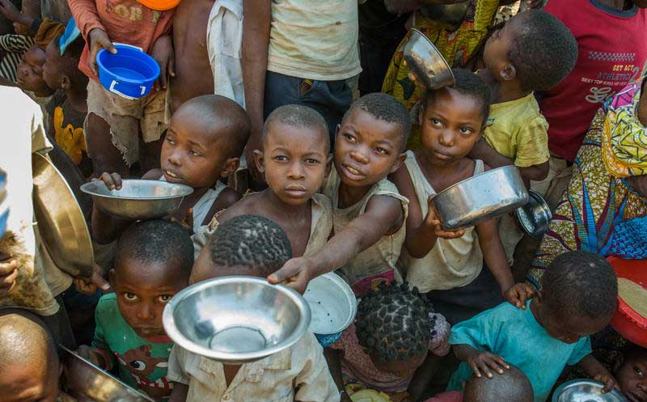
Poverty: Poverty is said to be both the cause and effect of environmental degradation. As we know, the more the resources are utilized, the more degraded the environment becomes. And the more the environment deteriorates, the more impoverished the poor will be.
Poverty
Urbanisation: You may have observed a large number of poor people from villages moving to towns, cities and mega cities to earn their livelihood. This has led to unplanned and rapid expansion of cities, creating enormous pressure on the infrastructural facilities. Urban slums are major sources of pollution and suffer from the worst kind of unhygienic conditions. The fast pace of urbanisation has also been responsible for the depletion of forests and irrational use of other resources.
PAGE 15

Slide 18
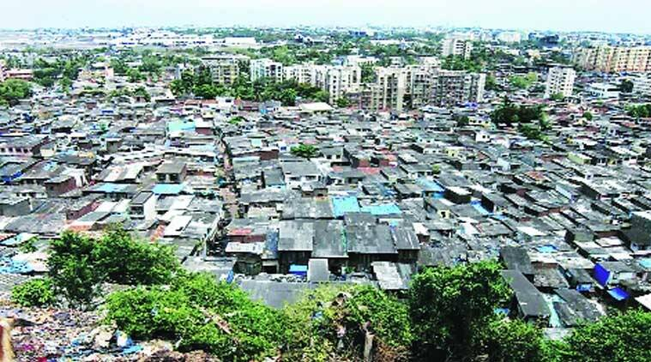
Urban slum
Changing Life Style: There has been a remarkable change in the style of living of people. This change is visible not only among the people living in cities and towns but also among those who live in villages. The changing life style of people has enormously increased their level of consumption.
The fallout of the fast increasing use of modern gadgets like refrigerators and air conditioners is the release of harmful gases in the atmosphere. This has been causing global warming which is very dangerous.
PAGE 16

Slide 19
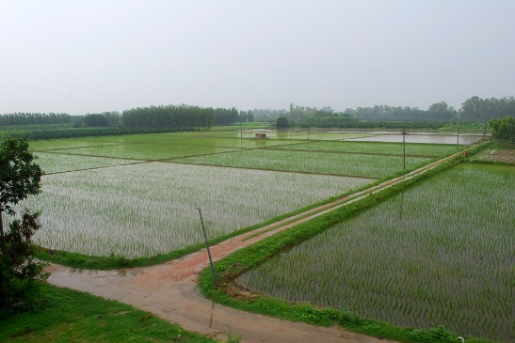
In fact, due to overuse of modern gadgets, harmful gases like carbon monoxide and carbon dioxide are released which lead to global warming. Chloro fluoro Carbon (CFC): It is an inert lifeless gas. But when it comes into contact with other gases, it becomes harmful. It is responsible for depletion of the ozone layer.
Economic Factors
Agricultural Development: Farming activities especially directed towards increasing agricultural production have a direct impact on environment. These activities have been contributing to soil erosion, land salination, alkalization and loss of nutrients. As we have been experiencing in India, the green revolution has led to over exploitation of land and water resources.
PAGE 17
Green revolution was both a virtue and a vice

Slide 20
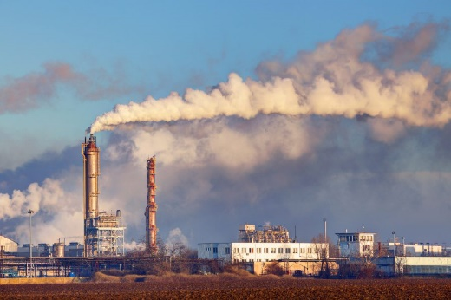
Extensive use of fertilizers and pesticides has been a major source of contamination of water bodies and land degradation.
Industrialization: Rapid industrialization has been the foremost contributor to environmental degradation. These technologies lead to intensive use of resources and energy. The current pace of industrialization therefore is resulting in the depletion of natural resources like fossil fuel, minerals and timber, and contamination of water, air and land. All these are causing immense damage to ecosystems and leading to health hazards.
PAGE 18
Industrialization

Slide 21
Economic Development: It is a fact that the pattern of economic development has also been creating environmental problems. The pace of economic development has been putting immense pressure on resources. The irrational use of resources and wastages are resulting in depletion of environment..
IMPLICATIONS OF ENVIRONMENTAL DEGRADATION
The degradation of environment is thus a very serious concern. And it is occurring primarily due to excessive and reckless exploitation and unscientific management of natural resources. In fact, it has emerged as a global challenge for all the countries of the world. As stated above, the pollution of air, water and soil caused by emission of harmful gases, release of industrial effluents, urban wastes and radio-active wastes and reckless use of fertilizers and pesticides is threatening the very survival of modern civilization.
PAGE 19

Slide 22
SUSTAINABLE DEVELOPMENT
The concept of sustainable development has emerged as an alternative model that will halt environmental degradation. It has a particular meaning in the context of environment and development relationships.
It is defined as development that meets the needs of the present generation without compromising the ability of future generations to meet their own needs. We can achieve the goal of sustainable development by managing the scientific use of our natural resources.
DISASTER MANAGEMENT
Disasters have become one of the greatest challenges, but they can be managed. We may better understand disaster management by understanding the term disaster. A disaster is the tragedy that negatively affects society and environment. Disasters are seen as the consequence of inappropriately managed risks.
PAGE 20

Slide 23
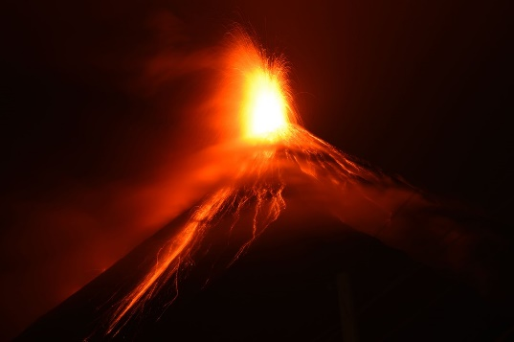
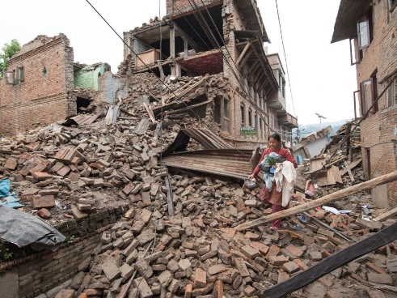
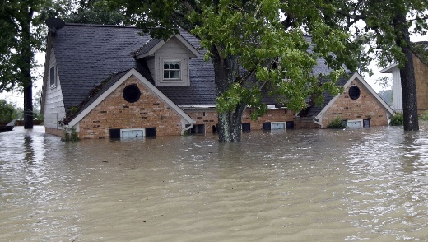
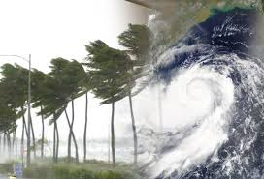
These can be classified into two categories based on their origin:
Natural Disasters
Human made Disasters.
A natural disaster occurs when a natural hazard (e.g., volcanic eruption or earthquake or flood) affects human life.
Volcanic eruption
Earthquake
Flood
Cyclone
PAGE 21

Slide 24
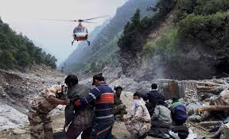
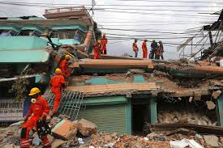
Disasters caused by human action, such as negligence, error, or by the failure of a system are called human- made disasters. Examples of such disasters are: Bhopal Gas Tragedy, Landslides that take place in different parts of our country or Floods due to breaches in dams. Global Warming is going to be a great disaster, and it is also the result of human interference with the natural environment.
Minimizing the adverse effects of natural and human-made disasters by adopting suitable strategies is called disaster management. Its process involves four phases:
Mitigation
Preparedness
Response
PAGE 22
Disaster management team

Slide 25
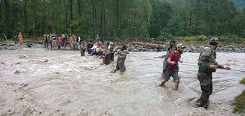
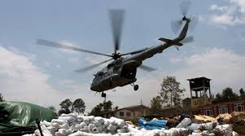
Helping people during flood
Providing relief
Mitigation
It means the efforts that are made to prevent hazards from developing into disasters, or to reduce the effects of disasters to the minimum, when they occur. The mitigation phase differs from the other phases because it focuses on long-term measures for reducing or eliminating risks. Even before the phase of mitigation, there may be a phase of the identification of risks. It is better to identify the risks before you plan and make efforts to reduce the impact of disaster.
PAGE 22

Slide 26
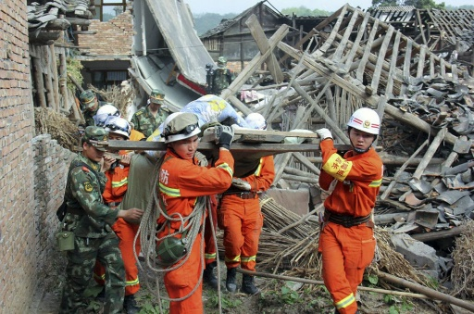
Preparedness
In the preparedness phase, disaster managers develop plans of action for when the disaster strikes. This includes:
(a)Communication plans with easily understandable terminology and methods
(b) Proper maintenance and training of emergency services
(c) Development of emergency shelters and evacuation plans
(d) Getting ready and maintaining disaster supplies and equipment
(e) Developing organization of trained volunteers among civilian populations.
PAGE 22
Rescue operation during earthquake

Slide 27
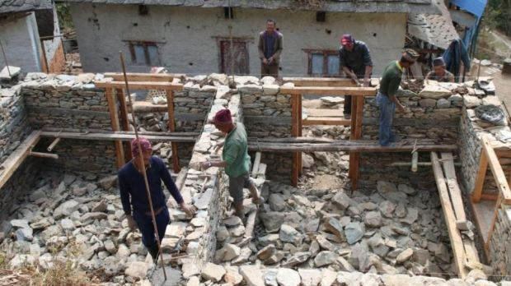
Response
When a disaster occurs, actions under the response phase are taken. These include the mobilization of the necessary emergency services and also of people who respond immediately in the disaster area. This is likely to include emergency services, such as firefighters, police and ambulance crews. A well planned strategy as part of the preparedness phase enables efficient coordination of rescue.
Recovery
The aim of the recovery phase is to restore the affected area to its previous state. It differs from the response phase in its focus. Recovery efforts are primarily concerned with actions that involve rebuilding destroyed property, re-employment, and the repair of essential infrastructure.
PAGE 23
Recovery after natural calamity

Slide 28
EXCERCISE
1. Put the following into biotic and abiotic groups:
Plants, Water, Soil, Animals, Fire, Microbes, Topography, Bacteria. Biotic Abiotic.
Ans. Biotic – Plants, animals, microbes, bacteria
Abiotic – water, soil, fire, topography
2. Fill in the blanks with appropriate words:
(a) Environment can be classified into Natural and Man made
(b) The classification of environment can also be made on the basis of its Creation or its evolution.
(c) Road, buildings and school are parts of Creation or its evolution.
(d) Environment is dynamic because it changes over a period of time and space.
PAGE 24

Slide 29
1. Fill in the blanks with appropriate words.
(a) When habitats are destroyed bio-diversity is lost.
(b) Modern gadgets release harmful gases and causes global warming.
(c) Extensive use of fertilizers and pesticides have been a major source of Contamination of water bodies and land degradation.
(d) One of the biggest causes of environmental degradation is generation of Solid wastes.
2. What is disaster? Give any one example
Ans. A disaster is the tragedy that negatively affects society and environment. Example Bhopal gas tragedy, Tsunamis, Landslides, London Smog, floods, earthquakes
PAGE 25

Slide 30
THANK YOU

